Slide 1
Competitive Programming
21 Oct. 2022
Andrei Novikov

Slide 2
Revise Homework - Overview
Book: “Competitive Programming 3”.
Algorithms:
Bridges and Articulations Algorithm
Tarjan’s Algorithm
Tasks:
- UVa 00610 – Street Directions (Link)
- UVa 00796 – Critical Links (Link)

Slide 3
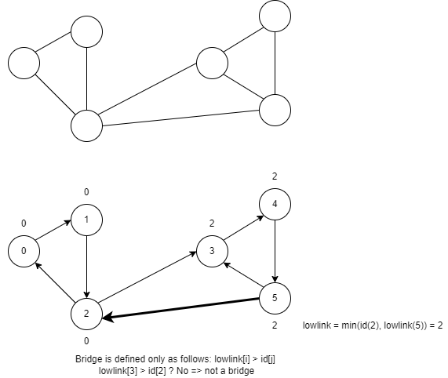
Repeat. What is a bridge?
Bridge is a link for which: lowlink[i] > id[j]
Pay attention:
lowlink[i] != lowlink[j] is NOT a bridge,
Look at nodes 5 and 2

Slide 4
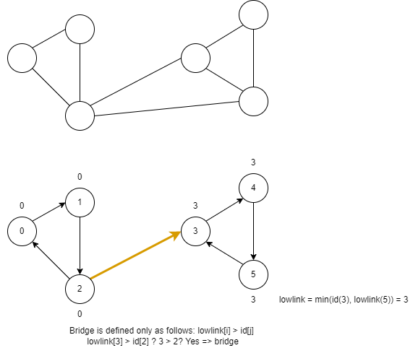
Repeat. What is a bridge?
Bridge is a link for which: lowlink[i] > id[j]
Pay attention:
lowlink[3] > id[2] it is a bridge

Slide 5
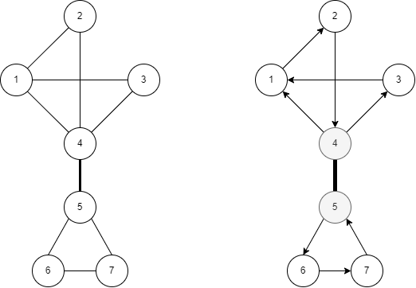
Revise Homework
UVa 00610 – Street Directions: Link
Solution: Link
DFS (IDs, LowLinks)
Bridge? No.
Connect if IDs[i] > IDs[nei]
Connect as DFS goes
Bridge? Yes. Keep connection

Slide 6
Revise Homework
UVa 00796 – Critical Links: Link
Solution: Link
1. DFS to find LowLinks and IDs
2. Find Bridges

Slide 7
Life Practice – Challenge #1
Topic: Graph
Resource: Online Judge (Competitive Programming 3)
UVa 11709 – Trust Groups – Link

Slide 8
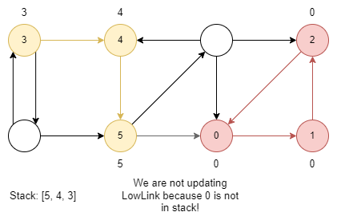
Life Practice – Challenge #1 – Solution
Groups that trust each other – are strongest connectivity components (SCC).
The optimal way to find strongest connectivity components is to use Tarjan’s algorithm.
The key moment of the algorithm is usage of stack to update lowlink value!

Slide 9
Life Practice – Challenge #2
Topic: Graph
Resource: Leetcode
0310 – Minimum Height Trees – Link

Slide 10
Home task
Competitive Programming 3.
Chapter 4.3 – Minimum Spanning Tree:
4.3.1
4.3.2
UVa 00352 – The Seasonal War
UVa 00657 – The Die is Cast

Slide 11
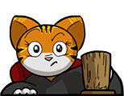



Where to Practice
LeetCode [link]
HackerRank [link]
Kattis [link]
TopCoder [link]
Other Resources

